Slide 1
Getting Information Governance right is integral to a successful PROMs system
A discussion to examine the best practice when navigating IG
Amplitude Clinical Outcomes – Information Governance

Slide 2
GDPR – How has it impacted you…..
Notes:
Everyone stand-up!
Sit down if you’ve never heard of GDPR
Should be no one!
Anyone who sat down - we can help you by providing an introduction, starting you on journey to understanding GDPR
Sit down if know about GDPR but don’t know how it applies to Amplitude
Anyone who sat down - We can help you by providing a checklist of useful information that will help you understand
Sit down if know about GDPR and how it applies to Amplitude but avoid too much thinking and doing anything about this
Anyone who sat down - We can help you by explaining how important this is and how Amplitude can support you to become more involved
Whoever is left we can assume knows about GDPR and understands how it applies to Amplitude and uses that knowledge actively on a day to day basis
Who’s left – Would you like to do this presentation!

Slide 3
Is GDPR the Elephant in the Room?
Notes:
GDPR / IG Feels like the Elephant in the room
We know its there, we know it has introduced changes, but most of us don’t really want to get involved in really understanding and applying the principles
GDPR / IG / DPIA – we recognise these aren’t the most exciting of topics but hopefully this short session will help you recognise the importance of this Elephant and provide you with a start point to be come the Elephant's friend

Slide 4
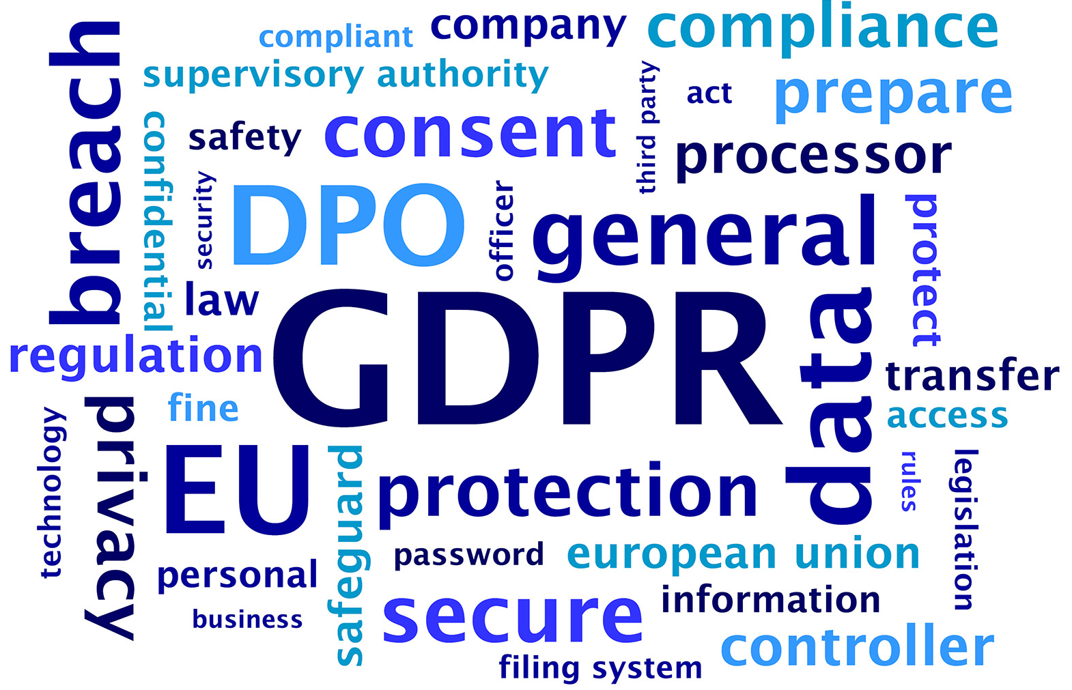
Recap on GDPR
Notes:
Recap on GDPR – May 2018 – what changed?
Rationalised legislation, harmonised it across Europe and brought it up-to-date for the digital age
Set out principles for processing personal data
Introduced higher fines for non-compliance
Introduced new rights for people to access their data
Introduced obligations for better data management
Overall put a spotlight on patient data and its management

Slide 5
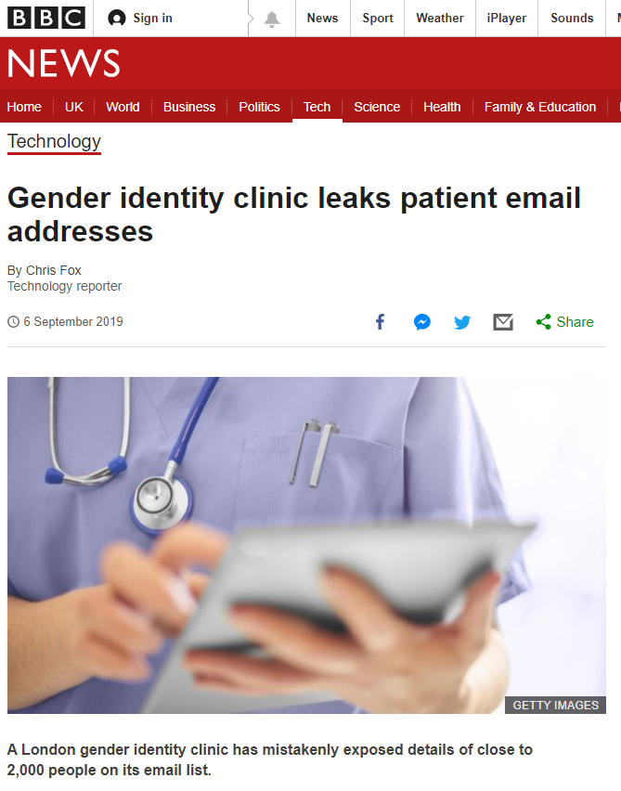
Reflection – has GDPR made a difference?
Charing Cross Gender Clinic
Leaked sensitive patient details – and is now being assessed by the ICO
Notes:
Big picture, in the wider world I would say that GDPR is making a difference
Example 1 – High profile exposure about the leakage of sensitive patient data – this example shows the reputational damage that can result if organisations don’t take GDPR seriously

Slide 6
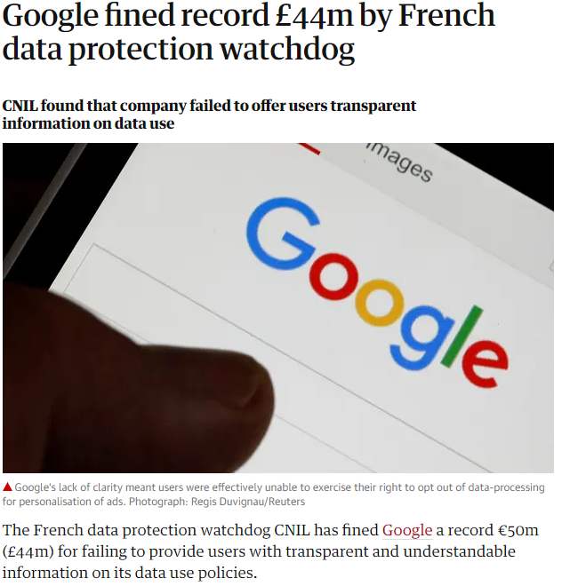
Reflection – has GDPR made a difference?
Google in France
Fined Euro50m by CNIL, 9,974 individuals – challenge on governance/rights.
Still in debate, when settled will set a strong precedence on governance & rights
Notes:
Example 2 – illustrates the interest that regulators are taking in governance and providing information about data use policies

Slide 7
Reflection – has GDPR made a difference?
British Airways 500,000 customers compromised in June 2018 - £183m
Notes:
Example 3 – illustrates the cost to an organisation where a patient breach occurs

Slide 8
Amplitude’s Reflections on the impact of GDPR
More scrutiny from IG – numerous Data Protection Impact Assessments (DPIA) to complete
More interest in the Consent Message
Greater scrutiny of patient data management, often requiring an assurance of patent deletion / patient anonymisation, once a patient isn’t being processed
Insistence on full and timely Breach management
What is your experience?
Notes:
What is Amplitude seeing?
As a Data Processor for a wide variety of organisations this is what we are seeing as we support our various organisations – the Data Controllers
I’m now going to explore some of these topics in a bit more details, with some ideas as to how you might respond to the IG issues

Slide 9
GDPR Topic 1 – Data Protection Impact Assessment
New and significant changes
Key things to remember
What is DPIA?
Notes:
What is DPIA?
A Data protection impact assessment (DPIA) is a process that helps organisations identify and minimise risks that result from data processing.
DPIAs are usually undertaken when introducing new data processing processes, systems or technologies.
DPIAs are a legal requirement under GDPR for data processing that is likely to be high risk and you may be fined if you don’t comply
New and significant changes
The GDPR does not specify a DPIA process to follow. Instead, it allows organisations to use a framework that complements their existing processes.
A good DPIA should help you demonstrate that you have considered the risks related to your intended processing and met your broader compliance obligations.
Whichever methodology your organisation uses, according to the ICO your DPIA must:
describe the nature, scope, context and purposes of the processing;
assess necessity, proportionality and compliance measures;
identify and assess risks to individuals; and
identify any additional measures to mitigate those risks.
Key things to remember
Your IG team will decided if a DPIA is required
If you are introducing Amplitude, or extending its usage you are VERY likely to require a DPIA
If you intend to do this we suggest you contact your IG/DPO pro-actively and work with them to complete the DPIA
Doing this early in the project ensures data processing is designed in from the start – Privacy by Design
You will be responsible for the DPIA, but Amplitude will be able to help you, using standard GDPR responses we have created over the last 18 months

Slide 10
GDPR Topic 2 – Lawful Basis for Processing
New and significant changes
Key things to remember
What is Lawful Basis for Processing?
Six lawful basis for processing:
Consent
Contract
Legal Obligation
Vital Interest
Public Task
Legitimate Interest
Notes:
What is Lawful Basis
GDPR set out 6 Lawful basis for processing
No single basis is ’better’ or more important than the others – which basis is most appropriate to use will depend on the organisation’s purpose and relationship with the individual.
Your organisation will decide which is the appropriate lawful basis
New & Significant Changes – with the GDPR focus this is often an area raised as a concern by DPOs/IG and this will be a topic in a normal DPIA
Registry
In the main, Amplitude Registries use patient consent as the lawful basis
However, with reference to discussions we have had with NHS England, a Registry can consider other relevant lawful bases
For example Legitimate interest can be argued under GPDR articles:
GDPR Article 6.1(e) processing is necessary for the performance of a task carried out in the public interest or in the exercise of official authority vested in the controller;
GDPR Article 9.2(h) processing is necessary for the purposes of preventive or occupational medicine, for the assessment of the working capacity of the employee, medical diagnosis, the provision of health or social care or treatment or the management of health or social care systems and services
Enterprise
Consent should not be essential as the use of Amplitude is linked to direct care and can be viewed as an extension of the medical record
Obtaining explicit consent from patients to enter their details can cause delays in being able to input the data;
Using alternative legal bases provided by GDPR, as long as patients are properly informed of the No Data Processing opt outs (usually via a Privacy Notice, which all registries have in place) reduces delays in entering the data
Key things to remember
The DPIA should guide which is the most appropriate Lawful basis
Amplitude is a highly configurable solution and can be adapted as required, for your need

Slide 11
GDPR Topic 3 – Right to withdraw / be forgotten
New and significant changes
Key things to remember
What is the right to be forgotten?
Notes:
What is the right to be forgotten?
The GDPR introduces a right for individuals to have personal data erased.
The right to erasure is also known as ‘the right to be forgotten’.
Individuals can make a request for erasure verbally or in writing.
You have one month to respond to a request.
The right is not absolute and only applies in certain circumstances.
This right is not the only way in which the GDPR places an obligation on you to consider whether to delete personal data.
New, and significant changes
This new right places more focus on there being processes for Deletion and Anonymisation
These process will occur, for example:
As time passes
the personal data is no longer necessary for the purpose which you originally collected or processed it for; For example on completion of PROMS data submission
On request
you are relying on consent as your lawful basis for holding the data, and the individual withdraws their consent;
You are relying on legitimate interests as your basis for processing, the individual objects to the processing of their data, and there is no overriding legitimate interest to continue this processing;
Your organisation will set the rules but you will be responsible for ensuring there are processes in place, and that they are followed
Key things to remember
The full data processing lifecycle has scrutiny like never before
Amplitude has enhanced functionality and introduced reports to help you with this.

Slide 12
GDPR Topic 4 – Data Breaches
New and significant changes
Key things to remember
What is a Data Breach?
Notes:
What is a Data Breach?
A data breach is a confirmed incident in which sensitive, confidential or otherwise protected data has been accessed and/or disclosed in an unauthorized fashion
New & Significant changes
Notification is critical, taking action to minimise impact equally so
The controller should communicate to the data subject a personal data breach, without undue delay, where that personal data breach is likely to result in a high risk to the rights and freedoms of the natural person in order to allow him or her to take the necessary precautions (GDPR Recital 86)
Key things to remember
Vulnerable areas are:
When you contact our Customer Support Desk – NEVER include more than 1 patient identifier when sending details by email
Extracting reports – ALWAYS save reports with patient identifiable data in a highly secure location
Logging out of Amplitude – NEVER leave screens open showing patient data
Amplitude monitors Customer Support breaches and will inform you within 24 (working) hours
Amplitude is constantly looking to improve processing to reduce chance of data breaches

Slide 13
Amplitude Information Governance Checklist / Resources
Generic links
GDPR https://ico.org.uk/media/for-organisations/guide-to-the-general-data-protection-regulation-gdpr-1-0.pdf
DPIA https://ico.org.uk/for-organisations/guide-to-data-protection/guide-to-the-general-data-protection-regulation-gdpr/data-protection-impact-assessments-dpias/
Amplitude links
Amplitude Privacy Policy Statement https://amplitude-clinical.com/amplitude-clinical-outcomes-privacy-policy-statement/
Azure certificates link https://amplitude-clinical.com/information-governance-information/
Knowledge base on consent https://amplitude-clinical.com/amplitude-clinical-knowledge-base/amplitude-clinical-knowledge-base/change-patients-consent/
Notes:
There’s lots of information out there, and the ICO is making frequent updates

Slide 14
Don’t mention the “B” word
Brexit
GDPR still applies and will continue to
The ICO says “The government intends to incorporate the GDPR into UK data protection law when we exit the EU – so in practice there will be little change to the core data protection principles, rights and obligations found in the GDPR.”
GDPR will continue in Europe so will still be relevant if trade / share data with Europe
If we leave, into the future, a UK specific set of rules might develop
Watch ICO - https://ico.org.uk/for-organisations/data-protection-and-brexit/

Slide 15
Don’t forget the Elephant You can be sure the Elephant won’t forget you

